Slide 1
NUTRITION AGENT (The Smartest AI Nutrition Assistant)
CAPSTONE PROJECT
Presented By:-
P RUDRA NAIR – C V Raman Global University – CSE(AIML)
Github link :– https://github.com/Newcoder-Rudra

Slide 2
OUTLINE
Problem Statement
Proposed System/Solution
System Development Approach
Algorithm & Deployment
Result
Conclusion
Future Scope
References

Slide 3
Problem Statement
In an era where health awareness is growing, individuals increasingly seek personalized nutrition guidance. However, most existing tools provide generic diet plans, lack real-time adaptability, and fail to consider a person's holistic lifestyle, cultural preferences, allergies, and evolving health conditions. Furthermore, dieticians and nutritionists face limitations in scaling personalized consultations due to time and resource constraints.

Slide 4
Proposed Solution
This project aims to develop “The Smartest AI Nutrition Assistant” using state-of-the-art generative AI models that:
Understand user inputs via text, voice, or image (e.g., food photos, grocery labels)
Generate personalized meal plans based on health goals, medical conditions, fitness routines, and preferences
Offer contextual explanations (e.g., “Why is this food better?”)
Adapt suggestions dynamically with continuous feedback
The system will leverage NLP, multimodal understanding, and large-scale dietary databases to bridge the gap between one-size-fits-all diet apps and in-person counseling.

Slide 5
System Approach
IBM Watsonx Assistant for interactive conversation management
Natural Language Processing (NLP) for understanding user queries
Computer Vision for analyzing food images and grocery labels
LLMs (Large Language Models) for generating contextual explanations and meal suggestions.
APIs and Databases: Integration with health APIs and food databases for personalized planning.
Cloud Deployment: IBM Cloud for hosting and scalability

Slide 6
Algorithm & Deployment
Algorithm Selection:
LLMs for contextual understanding and text generation (e.g., GPT or Watson NLP models)
Rule-based filtering and ranking for allergen detection and food preferences
Continuous learning via feedback loops
Data Input:
User’s health data, dietary preferences, allergies, daily routines, and fitness goals
Images of meals/grocery items
Real-time interaction via chat/voice
Training & Prediction Process:
Models trained on diverse dietary datasets and medical guidelines
Dynamic suggestion generation based on updated inputs and continuous interactions
Deployment:
Deployed as a cloud-hosted interactive agent on IBM Watsonx
Link: Nutrition_AI_Agent

Slide 7
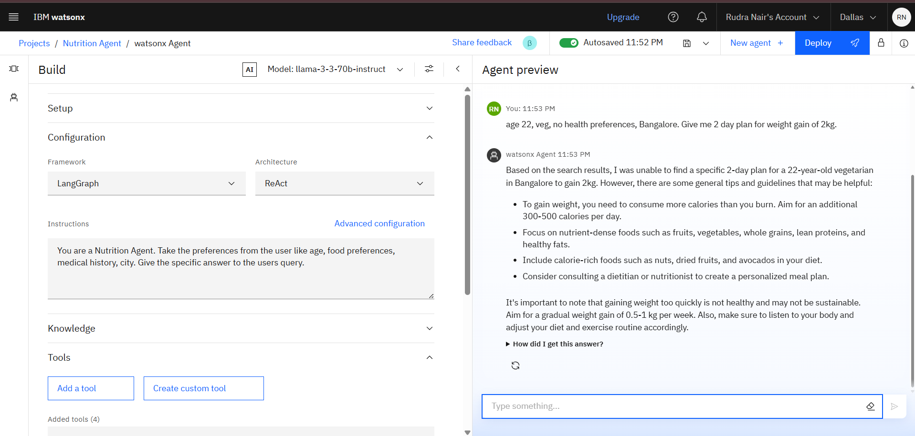
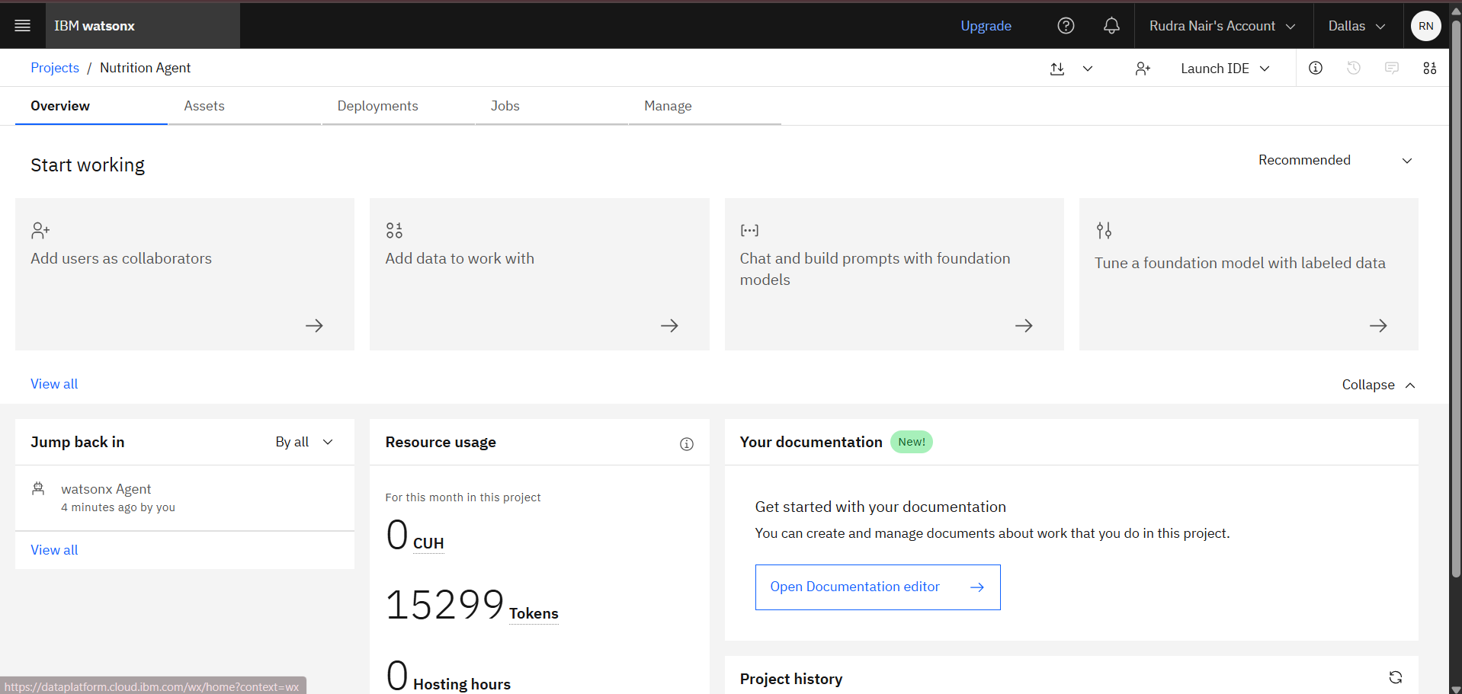
Result

Slide 8
Conclusion
The Smartest AI Nutrition Assistant demonstrates how generative AI and multimodal input can revolutionize nutrition planning.
It bridges the gap between impersonal apps and resource-limited human consultations.
By adapting in real-time and offering contextual insights, it provides a comprehensive and personalized nutrition experience.

Slide 9
Future scope
Integration with wearable devices for real-time biometrics
Multilingual support
Expanded regional and cultural food databases.
Offline accessibility using edge computing.
Deeper personalization using genetic/nutrigenomics data

Slide 10
References
IBM Watsonx documentation
Research on generative AI in healthcare
NLP-based dietary recommendation papers
Food and nutrition databases (USDA, FDC)
WHO & Indian Nutrition Guidelines

Slide 11
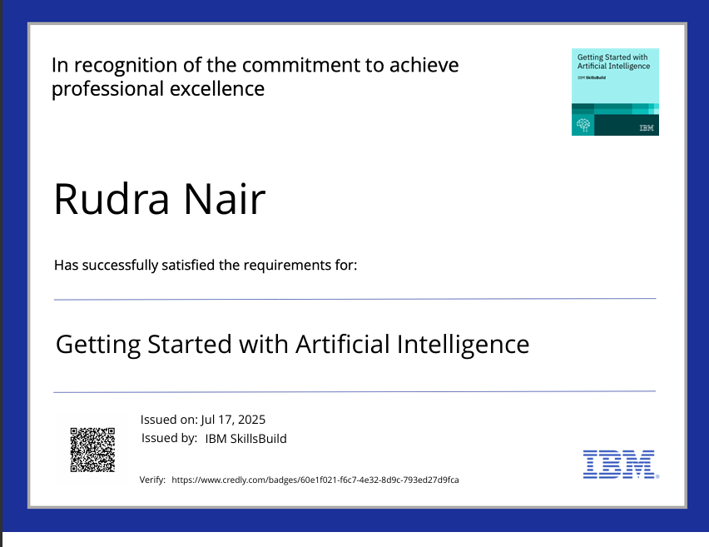
IBM Certifications

Slide 12
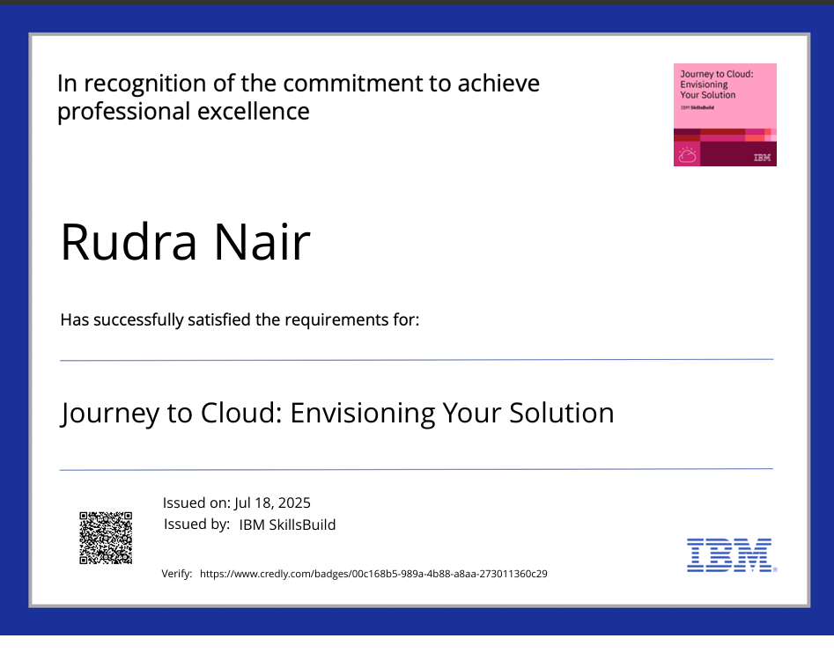
IBM Certifications

Slide 13
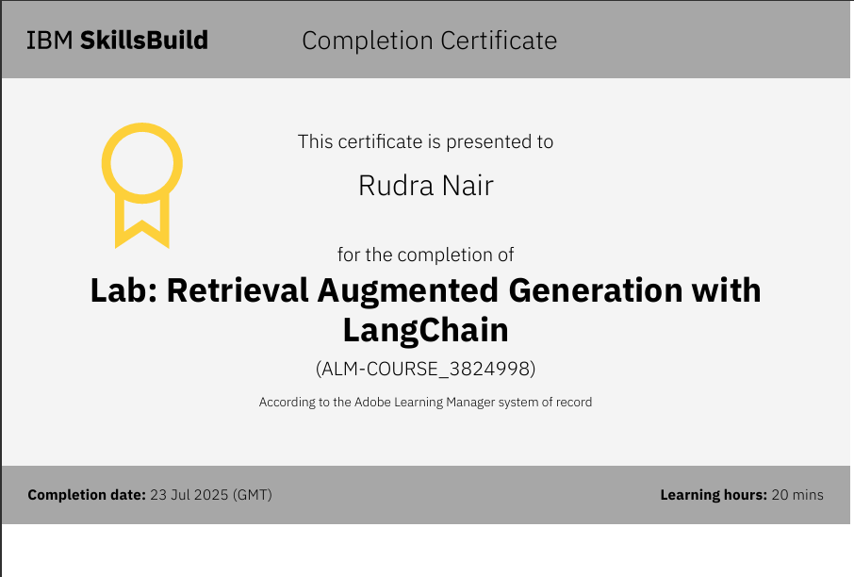
IBM Certifications

Slide 14
THANK YOU

